Slide 1
UML Diagrams

Slide 2
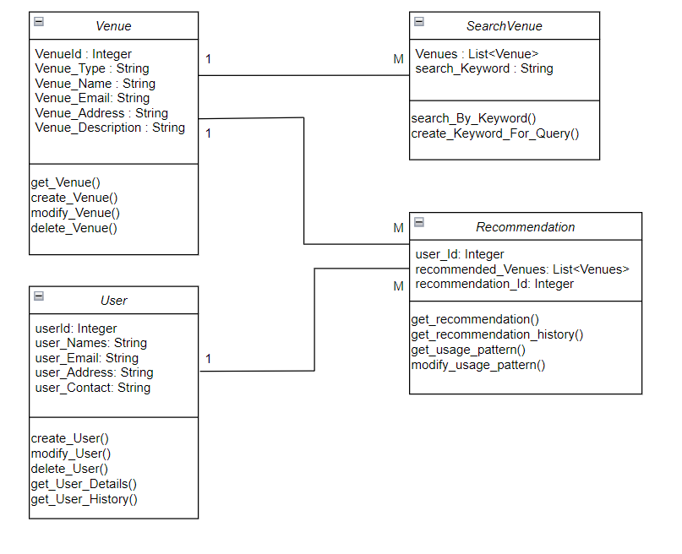
UML CLASS DIAGRAM APPLICATION : REVIEWER – 04.02 View Usage Pattern
04.03 Modify Suggestion Patterns

Slide 3
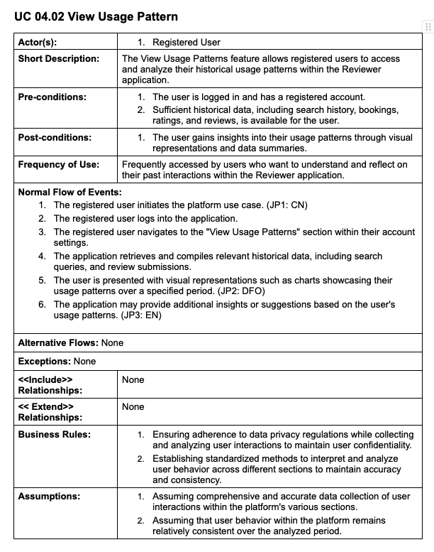
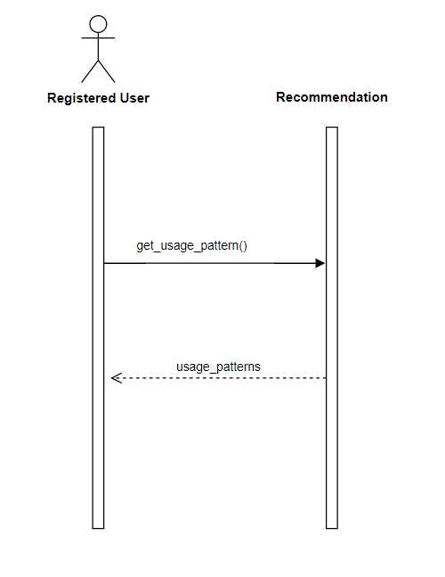
UML SEQUENCE DIAGRAM APPLICATION : REVIEWER – 04.02 View Usage Pattern

Slide 4
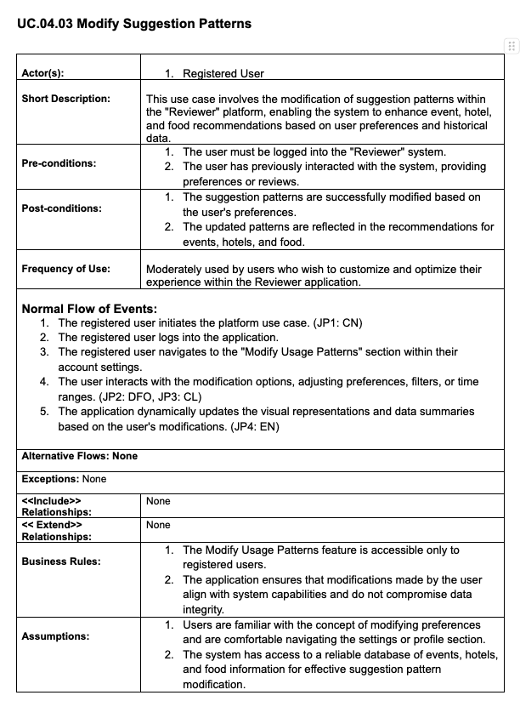
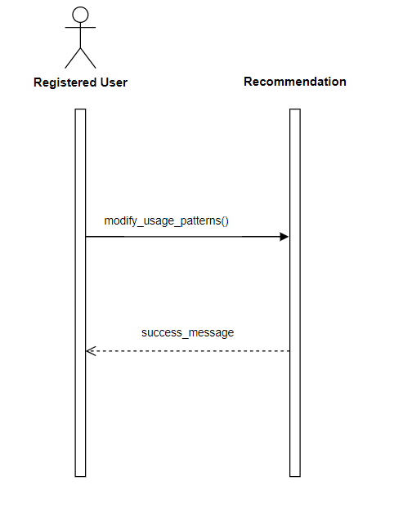
UML SEQUENCE DIAGRAM APPLICATION : REVIEWER – 04.03 Modify Suggestion Patterns

